Slide 1



VIDEO GAME SALES ANALYSIS
NIMISHA ANTONY

Slide 2
Video games
Games are meant to be interactive . They are a way for a person to immerse themselves in a different world.
A video game is an electronic game that involves interaction with a user interface or input device such as a joystick , controller or keyboard.

Slide 3
Why We Are Doing This Analysis?
Video games are part of almost everyone’s lives these days . Analysis of this data will help to identify the best gaming segment and the target region to achieve the maximum profit.
Based upon the data provided we may get business recommendations
This can further help them take decisions on their upcoming launch of games.
The report will help game owners as they can take business decisions by looking at how sales are affected over the period.

Slide 4
DATA SET
Collected the set of data’s of Video Game Sales from 1980 to 2020
DATA SOURCE : KAGGLE
11 unique variables
16598 Video Games

Slide 5
THE COLUMNS WE HAVE
RANK
NAME
PLATFORM
YEAR
GENRE
PUBLISHER
NA SALE
EU SALE
JP SALE
OTHER SALE
GLOBAL SALE

Slide 6
Here is what each column denotes.
Rank — Ranking of overall sales
Name — The games name
Platform — Platform of the game's release
Year — Year of the game’s release
Genre — Genre of the game
Publisher — Publisher of the game
NA Sales — Sales in North America (in millions)
EU Sales — Sales in Europe (in millions)
JP Sales — Sales in Japan (in millions)
Other Sales — Sales in the rest of the world (in millions)
Global Sales — Total worldwide sales.

Slide 7
Data visualization

Slide 8
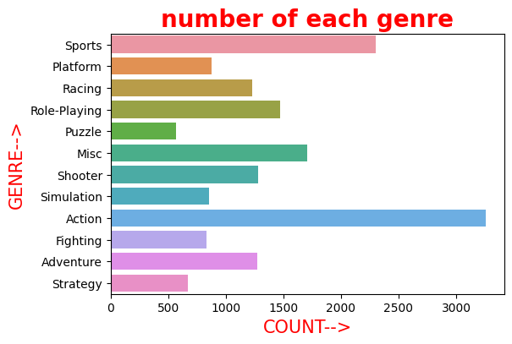
Action is the top most video game genre , Sports holds the second position. Where puzzle and Strategy are bottom position

Slide 9
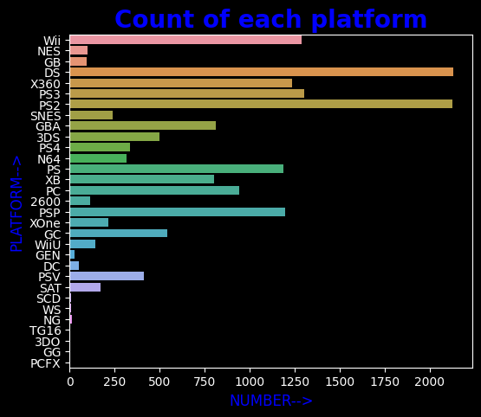
In the data set we see that the platforms in with the most games are playing is PS2 and DS

Slide 10
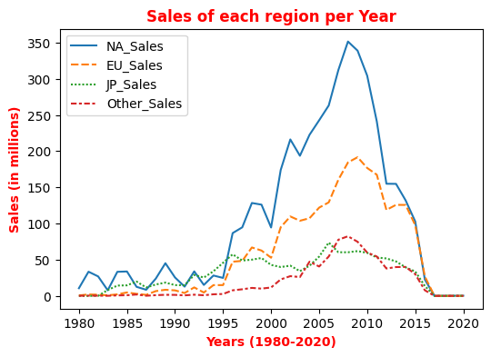
We see that video game sales reached its peak from around 2005-2010, but sales have since significantly dropped

Slide 11
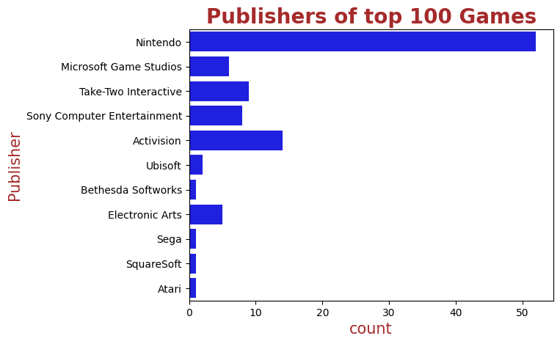
more than 50 of these 100 games were published by Nintendo. Microsoft Game Studios comes in 2nd place and Take-Two Interactive in 3rd place

Slide 12
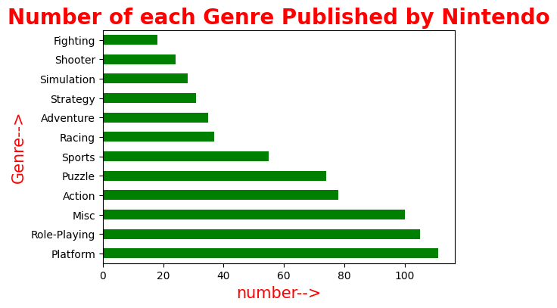
The top 3 genre of games that published by Nintendo are PLATFORM,ROLE-PLAYING,MISC. Where the least one is FIGHTING

Slide 13
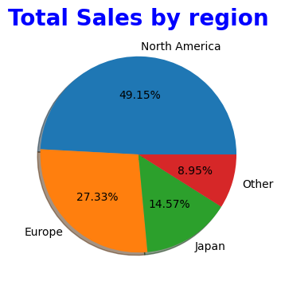
North America almost Cover 50% of sale and holds topper position

Slide 14
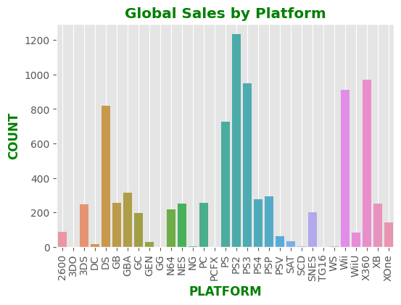
The biggest platform of Global Sales is PS2,followed by this the other top platforms are X360,PS3,DS,Wii

Slide 15
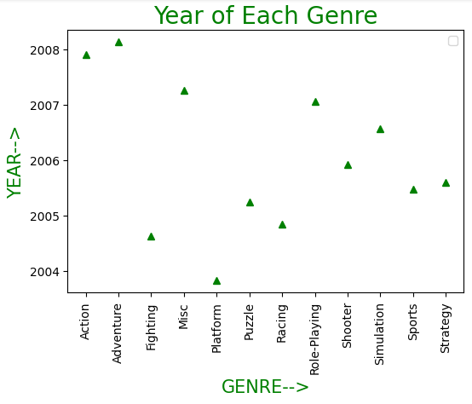
Most of the Action games are released in the year between 2007 and 2008.All genre of video games are released between 2004 and 2008

Slide 16
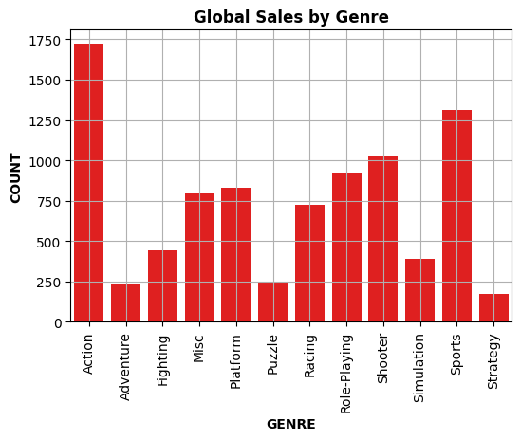
Here strategy is the bottom position and Action holds 1st position

Slide 17
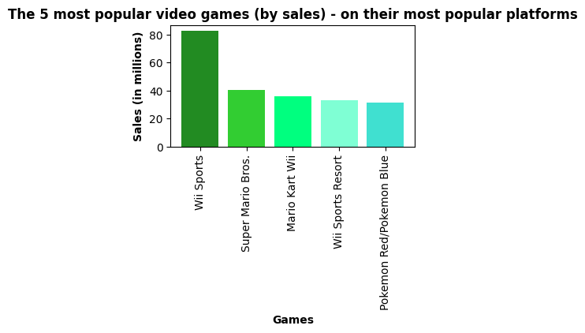
These are the 5 most video games on their most popular platforms . W ii sports holds number one

Slide 18
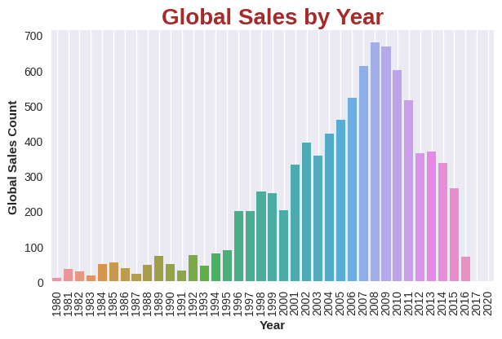
The global sales is maximum in year 2008,least in 2020 and 2017

Slide 19
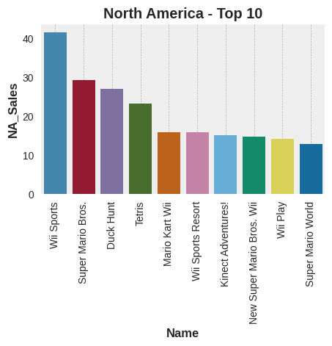
Here in North America the top most video game is Wii Sports

Slide 20
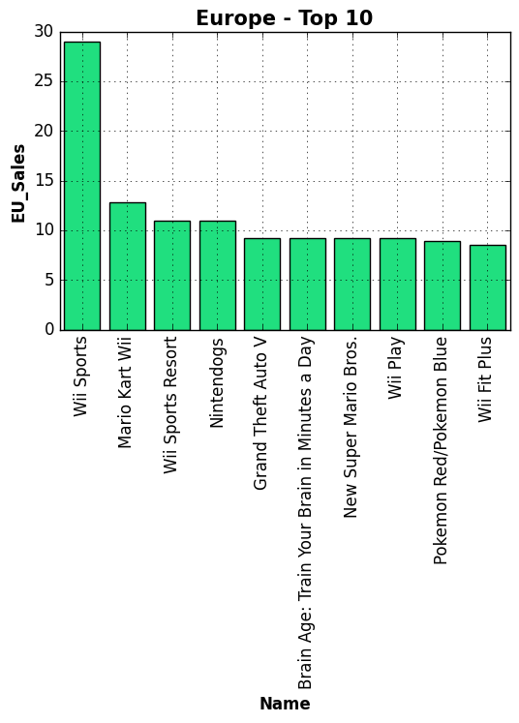
Like North America In
Europe
also the topper
position is Wii Sports

Slide 21
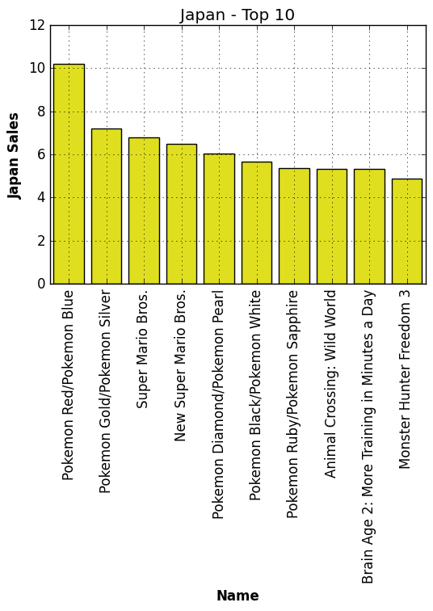
In Japan Pokemon Red/Pokemon Blue is topper

Slide 22
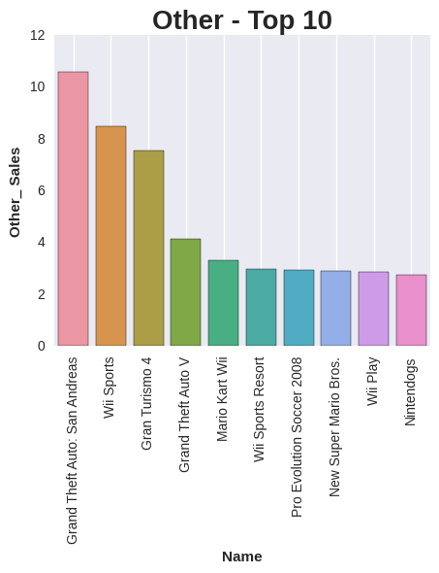
In other sales Grand Theft Auto is holds 1st, Also here Wii Sports also plays a big role

Slide 23
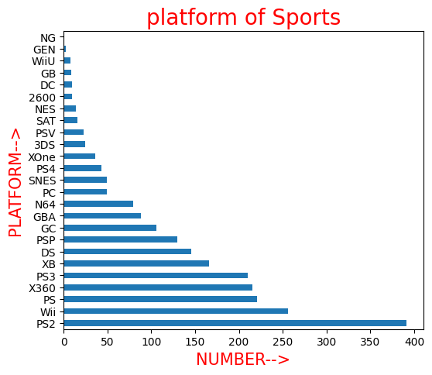
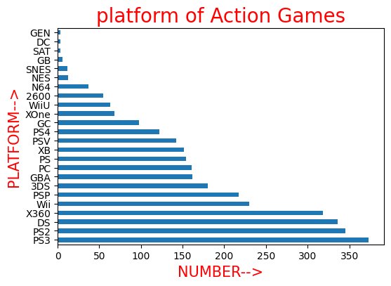
Action Games are mostly playing in PS2,PS3 platforms.
Sports Games are mostly playing in PS2,Wii platforms.

Slide 24
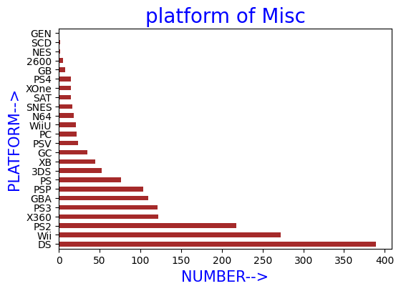
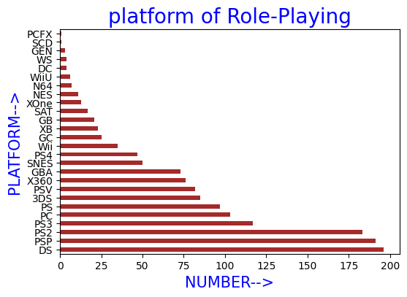
Misc Games are mostly playing in DS , Wii platforms
Role-Playing Games are
mostly playing in
DS,PSP platforms.

Slide 25
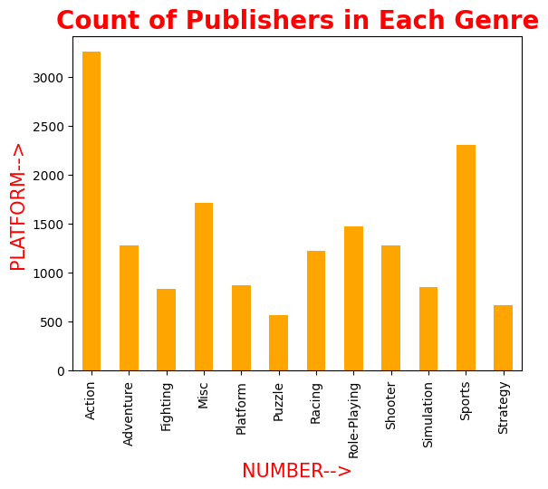
The number of publishers is maximum in action genre of games

Slide 26
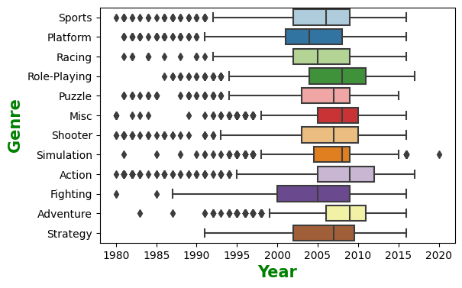
from the box plot we can concluded that most of the game genre there median is between 2005-2010

Slide 27
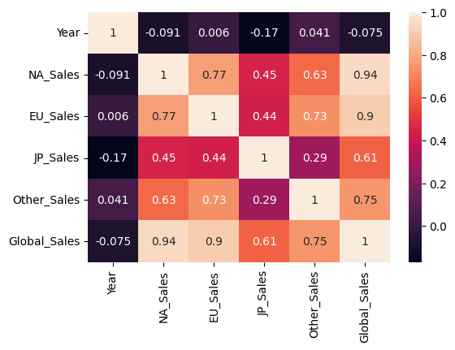
We can NA Sales and EU Sales have much effect in Global Sales. And NA Sales and EU Sales are mostly correlated

Slide 28
Action games are the more preferable games followed by sports, Thereby a new game launcher in action genre has high probability of getting the maximum sales
Japan is quite more stable in terms of sales through out decades . Though North America shows the highest sales.
Publisher Nintendo has earned more revenue so, we may follow their business strategy.
Gamming console like PS2,X360,Wii and DS more preferable platform for gamer.
North American Sales and European Sales have much effect in Global Sales
The number of publishers is maximum in action genre of games
CONCLUSIONS

Slide 29
We see that video game sales reached its peak from around 2005-2010, but sales have since significantly dropped , Global Sale is maximum in the Year 2008
North America almost Cover 50% of sale and holds higher position
The games like Sports and Misc Categories are mostly playing in Wii platform.
Both North America And Europe region Wii Sports hold first Position . So in future this platform has a better chance.
The trend of video game sales for North America has drastically decreased from 2008 which had highest sales recorded as about 350 million dollars.

Slide 30

Thank you

